Slide 1
An Update On ONYE’S Day
The little martian that created civilization
MARIE-ÈVE COUSINEAU

Slide 2
Change of Title
Onye’s Day
NUGGETS
OF A PLANET

Slide 3
Main Goal
The player has to combine elements together, which will one by one create a path towards the five Special Islands.
Once the five Special Islands are unlocked, the player wins.

Slide 4
Alchemy (no change)

Slide 5
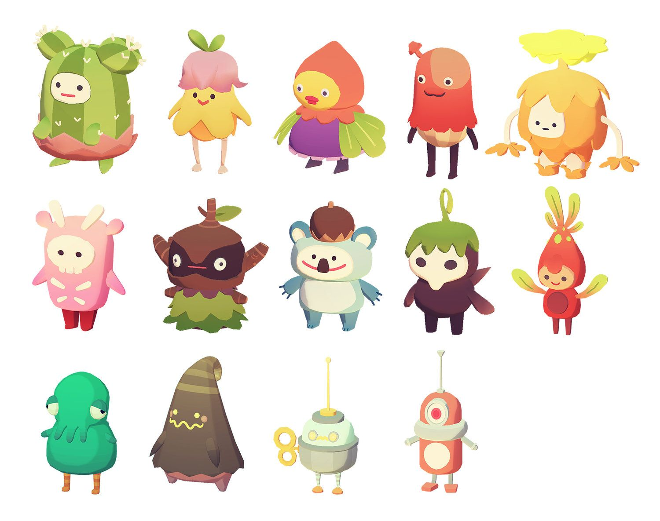
Character Inspiration
Ooblets

Slide 6
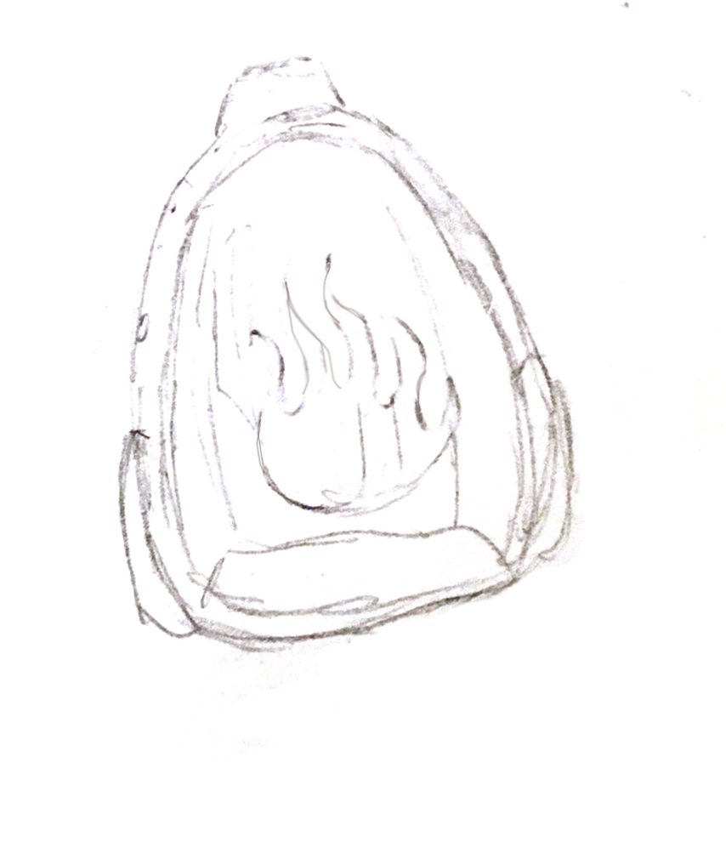
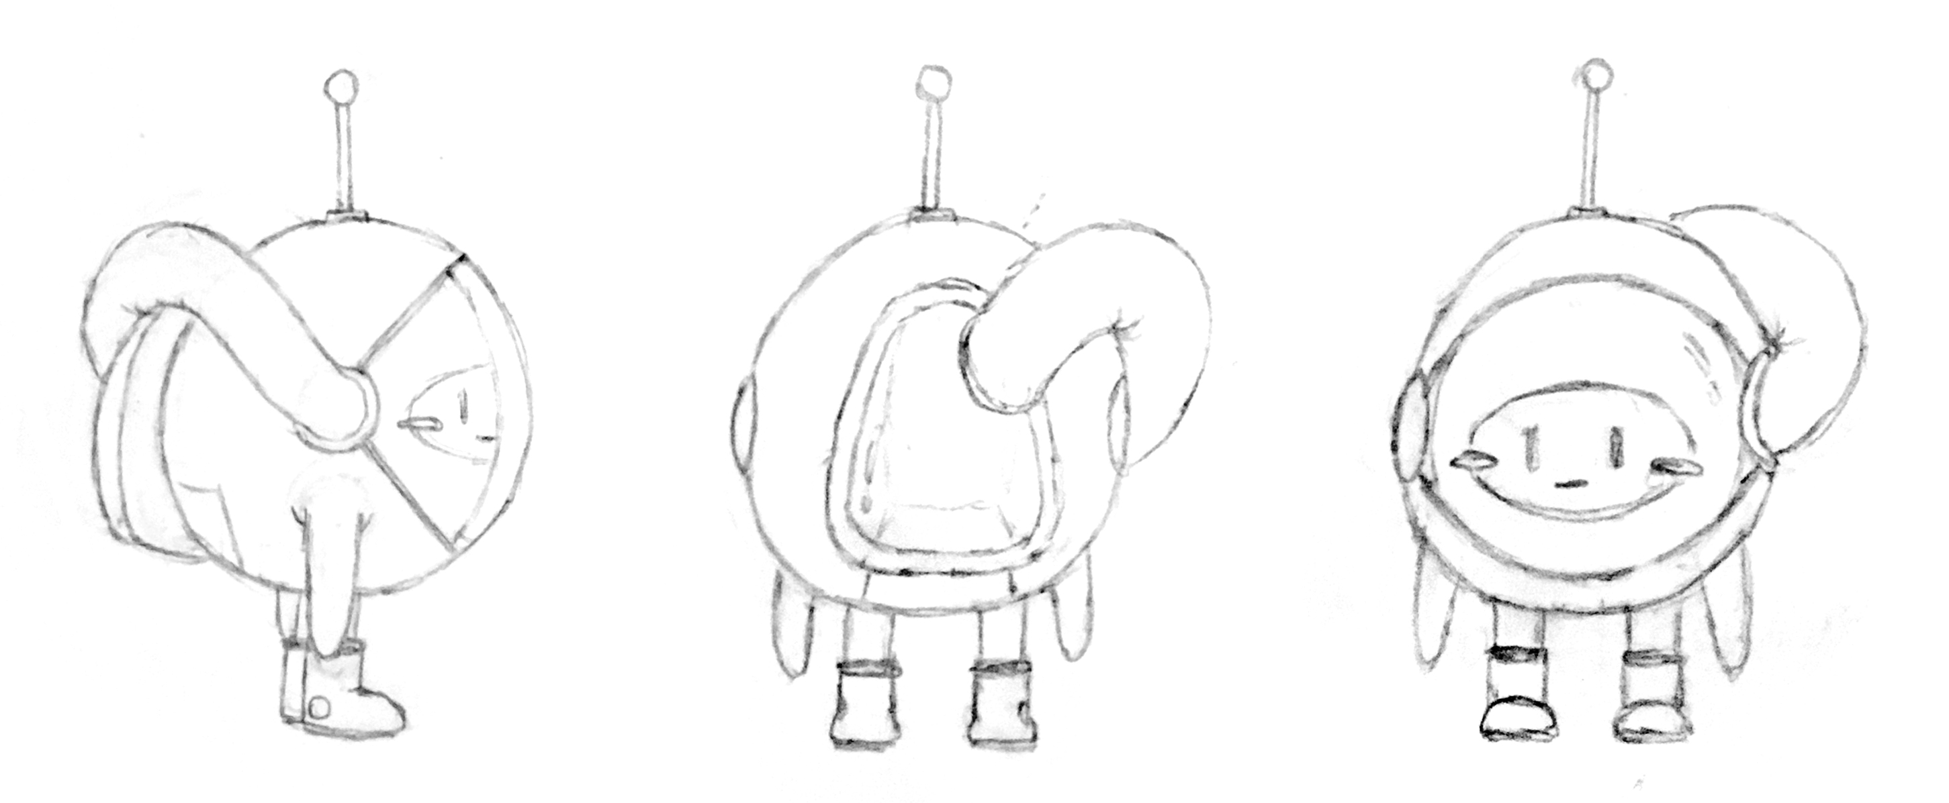
Character Sketching
Front, side and back view of Onye

Slide 7
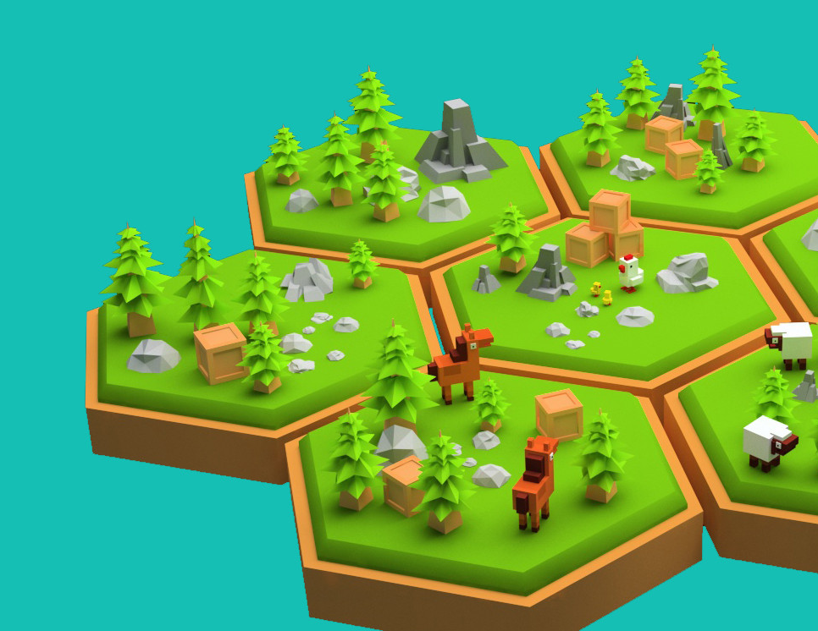
Islands Inspiration

Slide 8
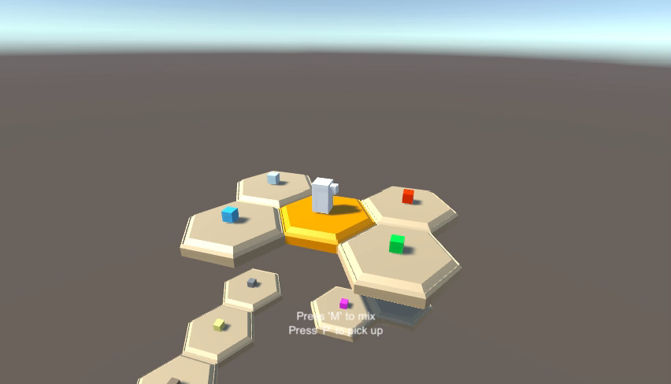
Prototype Demo
All the elements necessary for the creation of the Human Island have been implemented.

Slide 9
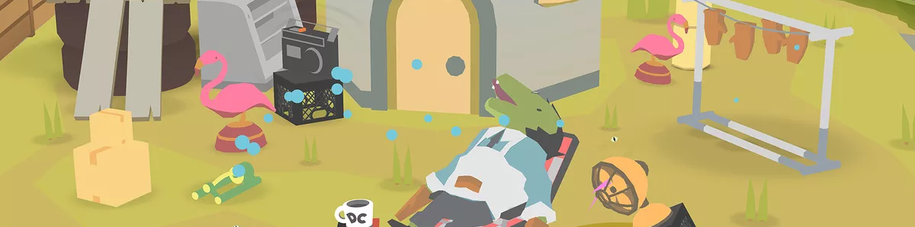
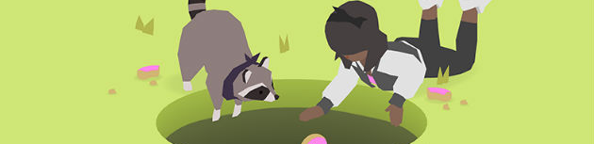
Graphic Style Inspiration
Donut County

Slide 10
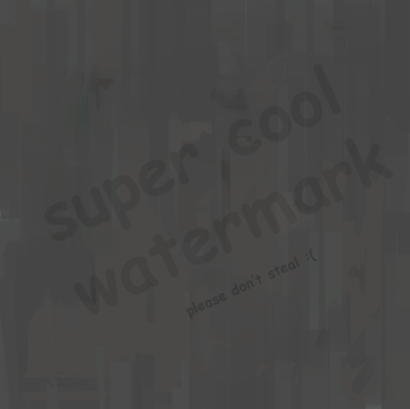
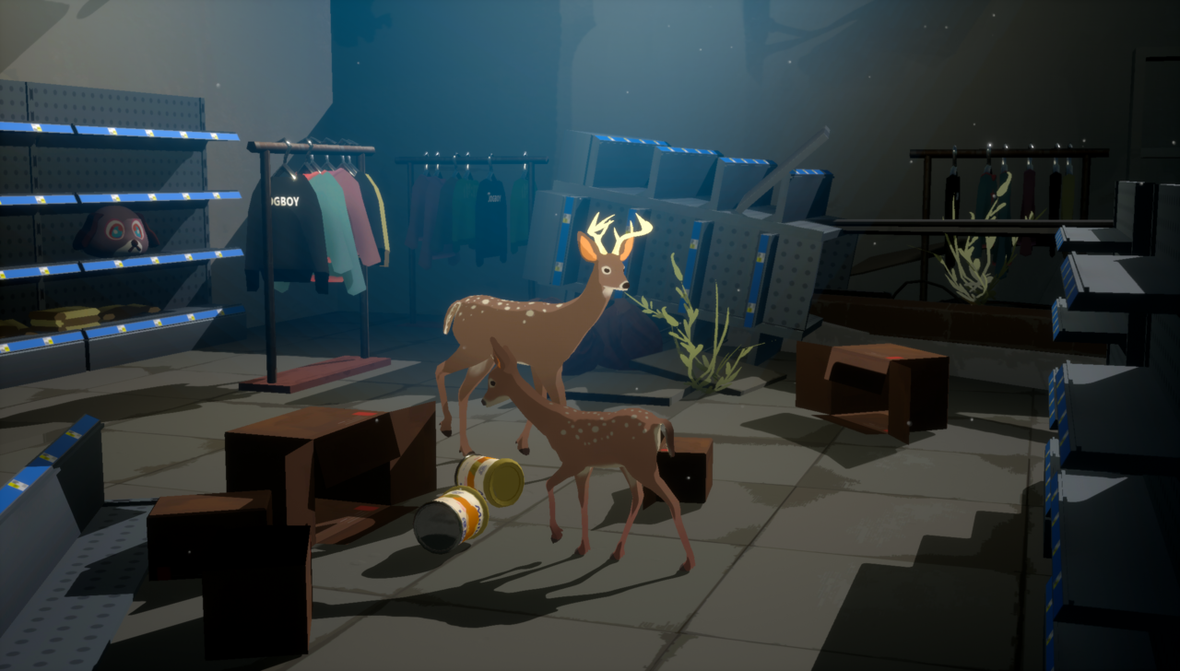
How To Achieve This Look
Texture example in Way To The Woods
Texture painted in Photoshop
with graphic tablet

Slide 11
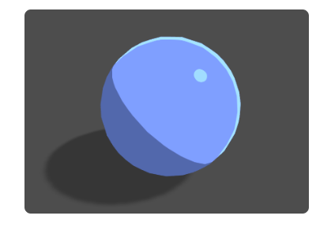
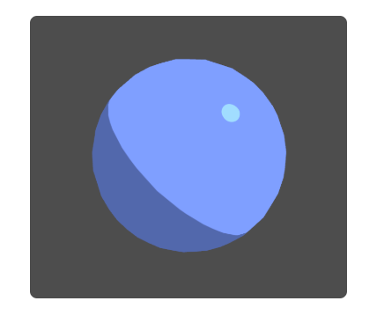
How To Achieve This Look
‘Unlit Shading’ or Toon Shader ?
Tutorial here

Slide 12
Next Steps
Model Onye in Blender and animate him.
Make sketches of elements and Special Islands.
Model those in Blender too.
Fix few bugs that I noticed already;
When you see the elemen tfloating for like 0.5 seconds?
Sometimes the islands stop mid-way in the air
Near Energy Island, player is stuck somehow
Put all the islands (elements) in the game.
Implement more GUI elements (text, feedback).
Improve visuals: textures, materials, nicer animations, etc.
Five Special Islands will be visible from the beginning, but ‘transparent’
Most importantly… A LOT OF PLAYTESTING.

Slide 13
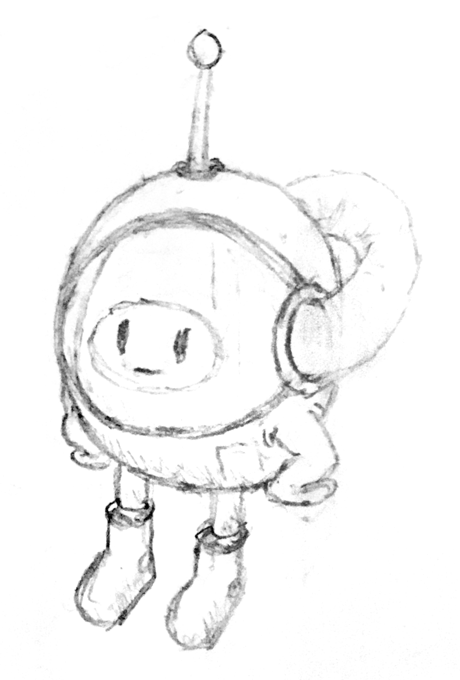
Onye Thanks You! ☺

